Slide 1
11th African Islamic Finance Summit 2024
Hargeisa, Somaliland
The Role of Regulatory Framework in the Development of Islamic Finance Industry
Syed Siddiq Ahmed
Senior Manager - Standards Implementation and Regulatory Authorities Relations - AAOIFI
Tuesday, 05 March 2024

Slide 3
East Africa and Somaliland
1.

Slide 4
Outline of the presentation
1
2
3
East Africa and Somaliland
Role of the regulatory framework in developing Islamic finance industry
Overview of AAOIFI

Slide 5
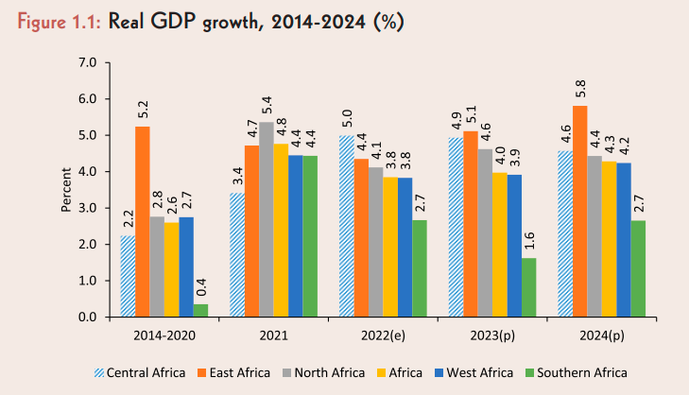
East Africa – Some key economic data
East Africa’s GDP of over USD 550 billion represents about 20% of the continent’s market size
East Africa’s population of over 400 million could double by 2050.
The region’s real GDP growth is projected to surpass the continental and global average over 2023-2024, despite the persistent headwinds.
East Africa’s economic growth in 2023 and 2024 would strengthen and is expected to be the highest among all of Africa’s regions. Economic growth in the East Africa’s region will accelerate to 5.1% in 2023 and 5.8% in 2024.
East Africa is home to the continent’s largest wind farm, the Lake Turkana wind plant in Kenya.
Source: African Development Bank - East Africa Economic Outlook 2023 - Mobilizing Private Sector Financing for Climate and Green Growth

Slide 6
Somaliland strengths
Political stability
Somaliland has maintained relative political stability since declaring independence in 1991. The region has experienced peaceful transitions of power through democratic elections.
Governance structures
Somaliland has established governance structures, including a constitution, parliament, and institutions, which contribute to the region's functioning as an autonomous entity.
Historical and cultural heritage
Somaliland is rich in historical and cultural heritage. The Laas Geel caves, known for ancient rock art, and other archaeological sites showcase the region's historical significance.
Resilient economy
Despite challenges, Somaliland's economy has shown resilience, with sectors such as livestock and remittances playing a crucial role in sustaining its economy.
Entrepreneurship and informal economy
The entrepreneurial spirit is strong in Somaliland, with a vibrant informal economy. Many individuals engage in small businesses and trade, contributing to economic activities.
Educational initiatives
Efforts have been made to rebuild the education system. Educational institutions, including universities, contribute to human capital development.
Water resources
Somaliland has some water resources, including rivers and underground aquifers, which are vital for sustaining agricultural activities.
Community and diaspora engagement
Community-based initiatives and engagement from its diaspora from around the globe is strong in Somaliland, fostering a sense of community and social cohesion.
Infrastructure development
Despite challenges, there have been efforts to develop infrastructure, including roads and ports, to facilitate economic activities and improve connectivity.

Slide 7
Role of the regulatory framework in developing Islamic finance industry
2.

Slide 8
Role of the regulatory framework in developing Somaliland
1. Sharia compliance
2. Legal recognition
3. Supervision, monitoring and risk management
4. International standards compliance
5. Training and capacity building
7. Collaboration with standards-setting bodies
8. Product innovation and development
9. Consumer protection
10. Disclosure and transparency
6. Technology integration
The primary role of the regulatory framework is to ensure that Islamic financial institutions adhere to Shari’ah principles. Regulations define what is considered Shari’ah-compliant, guiding the development and operation of Islamic financial products and services

Slide 9
Role of the regulatory framework in developing Somaliland (contd.)
1. Sharia compliance
2. Legal recognition
3. Supervision, monitoring and risk management
4. International standards compliance
5. Training and capacity building
7. Collaboration with standards-setting bodies
8. Product innovation and development
9. Consumer protection
10. Disclosure and transparency
6. Technology integration
A robust regulatory framework provides legal recognition to Islamic finance instruments, contracts, and transactions. This recognition is essential for creating a level playing field and instilling confidence among market participants, investors, and customers.
Legal recognition may also mean international recognition of the regulatory regime.

Slide 10
Role of the regulatory framework in developing Somaliland (contd.)
1. Sharia compliance
2. Legal recognition
3. Supervision, monitoring and risk management
4. International standards compliance
5. Training and capacity building
7. Collaboration with standards-setting bodies
8. Product innovation and development
9. Consumer protection
10. Disclosure and transparency
6. Technology integration
Regulatory bodies play a crucial role in supervising and monitoring Islamic financial institutions. Regular audits and examinations ensure compliance with Shari’ah principles and regulatory requirements, contributing to the industry's credibility.
Develop regulations that set standards for risk management practices within Islamic financial institutions. This includes guidelines for managing credit risk, market risk, and operational risk to ensure financial stability.

Slide 11
Role of the regulatory framework in developing Somaliland (contd.)
1. Sharia compliance
2. Legal recognition
3. Supervision, monitoring and risk management
4. International standards compliance
5. Training and capacity building
7. Collaboration with standards-setting bodies
8. Product innovation and development
9. Consumer protection
10. Disclosure and transparency
6. Technology integration
Many regulatory frameworks align with international standards set by organisations like the Accounting and Auditing Organization for Islamic Financial Institutions (AAOIFI) and the Islamic Financial Services Board (IFSB). This alignment facilitates international cooperation and enhances the industry's global standing.

Slide 12
Role of the regulatory framework in developing Somaliland (contd.)
1. Sharia compliance
2. Legal recognition
3. Supervision, monitoring and risk management
4. International standards compliance
5. Training and capacity building
7. Collaboration with standards-setting bodies
8. Product innovation and development
9. Consumer protection
10. Disclosure and transparency
6. Technology integration
Regulatory bodies and also respective financial institutions must enhance their human resources and build capacity
Organising training programs and capacity-building initiatives for professionals in the Islamic finance industry ensures that practitioners have the necessary skills and knowledge to operate within the regulatory framework.

Slide 13
Role of the regulatory framework in developing Somaliland (contd.)
1. Sharia compliance
2. Legal recognition
3. Supervision, monitoring and risk management
4. International standards compliance
5. Training and capacity building
7. Collaboration with standards-setting bodies
8. Product innovation and development
9. Consumer protection
10. Disclosure and transparency
6. Technology integration
As technology becomes more prevalent in finance, regulatory frameworks must address the integration of technology needs. Guidelines related to digital banking, FinTech, Blockchain, AI etc. should be included to promote innovation while ensuring compliance with Shari’ah principles.

Slide 14
Role of the regulatory framework in developing Somaliland (contd.)
1. Sharia compliance
2. Legal recognition
3. Supervision, monitoring and risk management
4. International standards compliance
5. Training and capacity building
7. Collaboration with standards-setting bodies
8. Product innovation and development
9. Consumer protection
10. Disclosure and transparency
6. Technology integration
Regulatory authorities often collaborate with international standard-setting bodies to harmonise practices and promote consistency in the global Islamic finance industry. This collaboration enhances the industry's credibility and facilitates cross-border transactions.

Slide 15
Role of the regulatory framework in developing Somaliland (contd.)
1. Sharia compliance
2. Legal recognition
3. Supervision, monitoring and risk management
4. International standards compliance
5. Training and capacity building
7. Collaboration with standards-setting bodies
8. Product innovation and development
9. Consumer protection
10. Disclosure and transparency
6. Technology integration
Should encourage product development and innovation. Regulations guide the development of new Islamic financial products, fostering creativity while ensuring adherence to ethical and legal standards.

Slide 16
Role of the regulatory framework in developing Somaliland (contd.)
1. Sharia compliance
2. Legal recognition
3. Supervision, monitoring and risk management
4. International standards compliance
5. Training and capacity building
7. Collaboration with standards-setting bodies
8. Product innovation and development
9. Consumer protection
10. Disclosure and transparency
6. Technology integration
Regulatory guidelines often include provisions for consumer protection. This ensures that customers are treated fairly, provided with transparent information, and have mechanisms for dispute resolution.
This can also be a cause for reputational risk to IFIs.

Slide 17
Role of the regulatory framework in developing Somaliland (contd.)
1. Sharia compliance
2. Legal recognition
3. Supervision, monitoring and risk management
4. International standards compliance
5. Training and capacity building
7. Collaboration with standards-setting bodies
8. Product innovation and development
9. Consumer protection
10. Disclosure and transparency
6. Technology integration
Regulations mandate transparency in financial reporting and disclosure. Islamic financial institutions are required to provide clear and comprehensive information about their operations, financial position, and risk exposure to stakeholders.
Example: AAOIFI Financial Accounting Standards (FAS)

Slide 18
AAOIFI – an overview
3.

Slide 19
AAOIFI – the organization – in a nutshell
Primary objectives
Secondary objectives
AAOIFI stands for ‘Accounting and Auditing Organization for Islamic Financial Institutions’
-
AAOIFI is a not-for-profit organization
Set up in 1991 by key industry stakeholders
-
187 active institutional members
-
General Assembly, BOT, PIMCC, Technical Boards, and Secretariat
123 standards and technical pronouncements in issue – 5 areas
Shari’ah – 59
Accounting – 37
Auditing – 8
Governance – 17
and
Ethics – 2
3 technical boards
Shari’ah Board Accounting Board Governance & Ethics Board
Adopted or adapted or used as guidance in more than 40 jurisdictions
-
Available in multiple languages
Capacity building
-
Advocacy and awareness
-
Technical bulletin – JOIFA
-
Advisory and assurance services
as of January 2024

Slide 20
Geographical footprint of AAOIFI
 | No. of regulatory jurisdictions |  |  | No. of countries
Levels of adoption | Shari’ah | Accounting | Governance | Shari’ah | Accounting | Governance
Adoption as part of law | 1 | - | - | 1 | - | -
Full adoption | 17 | 23 | 13 | 13 | 16 | 12
Partial adoption | 8 | 11 | 10 | 6 | 9 | 9
Guidance / reference material | 10 | 5 | 9 | 15 | 10 | 14
Local standards based on AAOIFI standards | 4 | 5 | 3 | 4 | 5 | 3
Guidance & local standards based on AAOIFI standards | 1 | 3 | 5 | 1 | 2 | 4
Supplementary reporting | - | 3 | - | - | 3 | -
Total | 41 | 47 | 41 | 38 | 42 | 41
Source: SECP

Slide 21
AAOIFI fellowship programs
Professional fellowship programs of AAOIFI
Certified Islamic Professional Accountant (CIPA)
English
Arabic
Russian
Certified Shari’ah Expert (CSE)
Arabic
Certified Shari’ah Auditor (CSA)
Arabic
Certified Shari’ah Advisor and Auditor (CSAA)
To be discontinued

Slide 22
Professional workshops
10-day workshop on summary of AAOIFI standards
To summarize the key requirements of the most important standards, including its implementation implications, in each area of standard-setting (Shari’ah, accounting, auditing, governance, and ethics)
Directors Sensitisation Program
To help the directors and senior management of Islamic Financial Institutions (IFIs) understand diverse topic areas: AAOIFI, IFSB, IIFM standards, takaful, risk management, capital adequacy, profit and loss distribution, and sukuk, respectively
Professional Ethics Program (PEP)
To train the employees in understanding the demands of ethical conduct and choosing the right course of action in an ethical dilemma or difficulty.
10-day CIPA / CSAA crash course program
To cover the given curriculum of CIPA and CSAA programs in the most effective manner (by discussing only key points) and in the shortest amount possible
3-day AAOIFI refresher workshops
To cover the most important and recently issued standards of AAOIFI

Slide 23
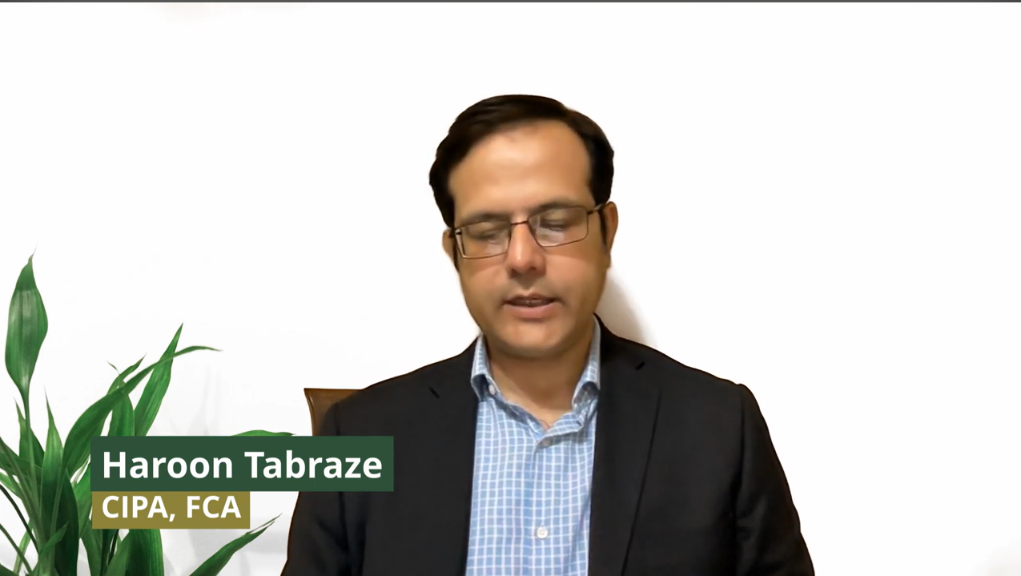
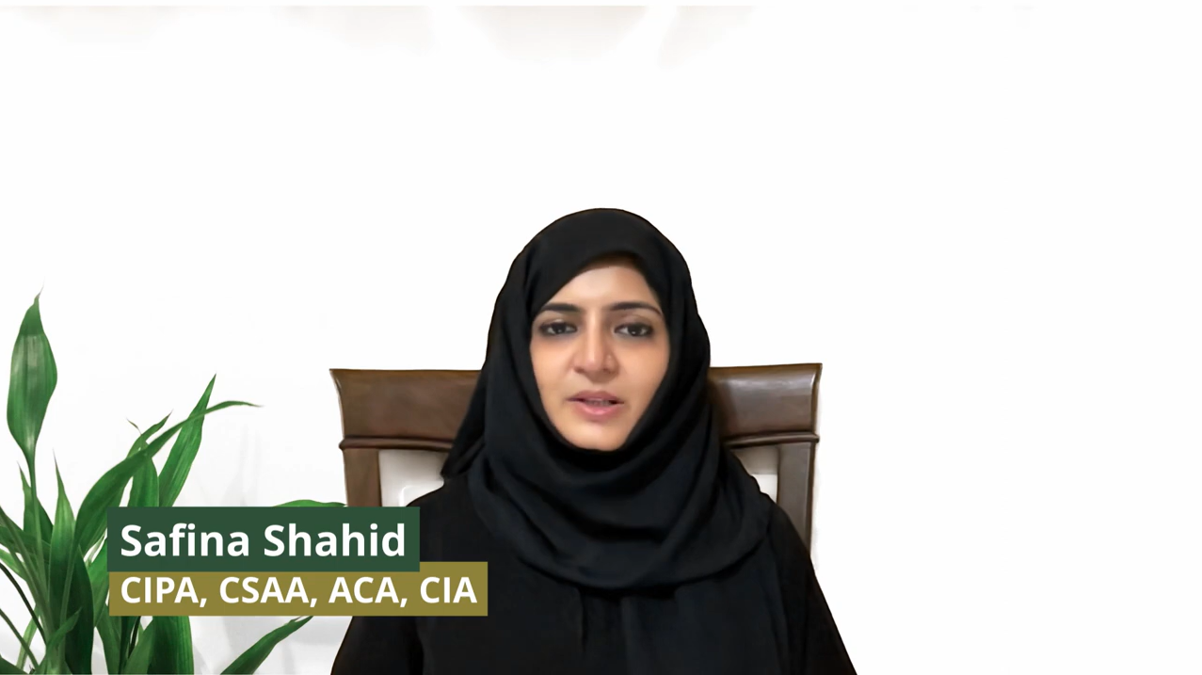
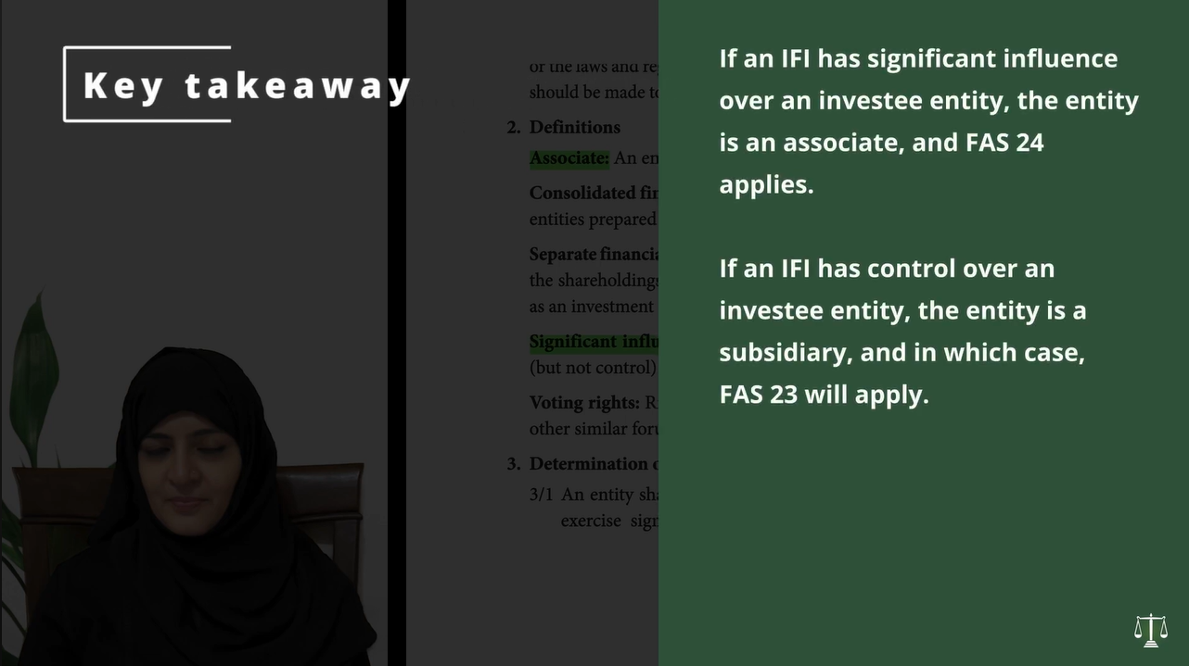
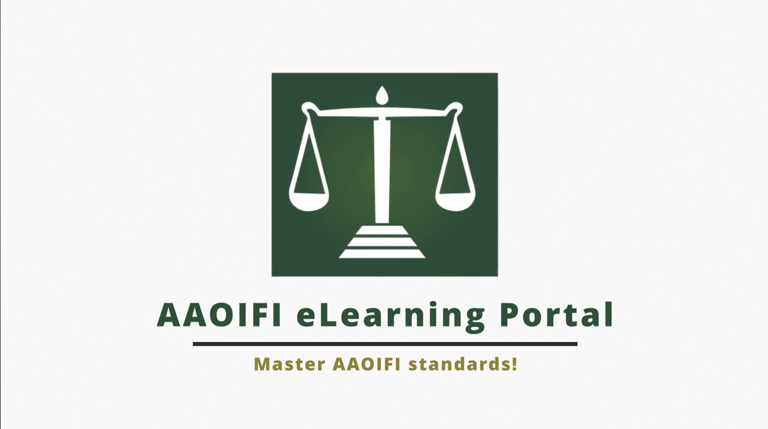
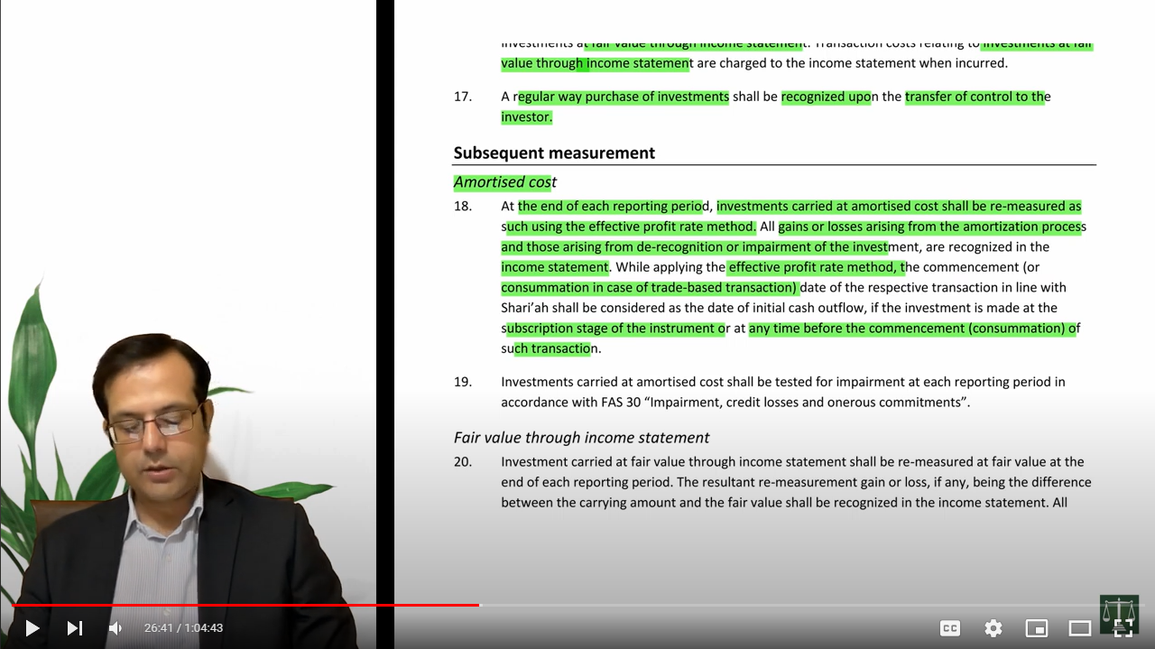
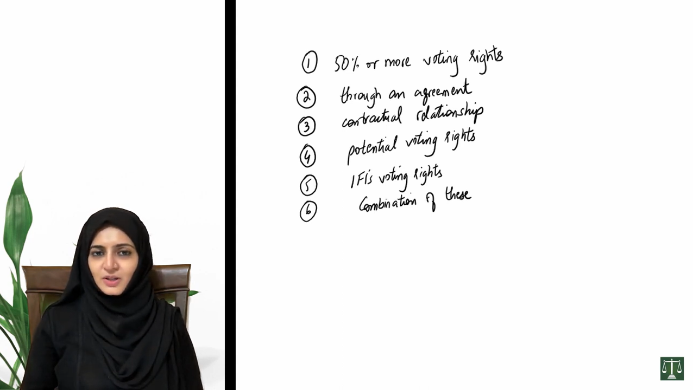
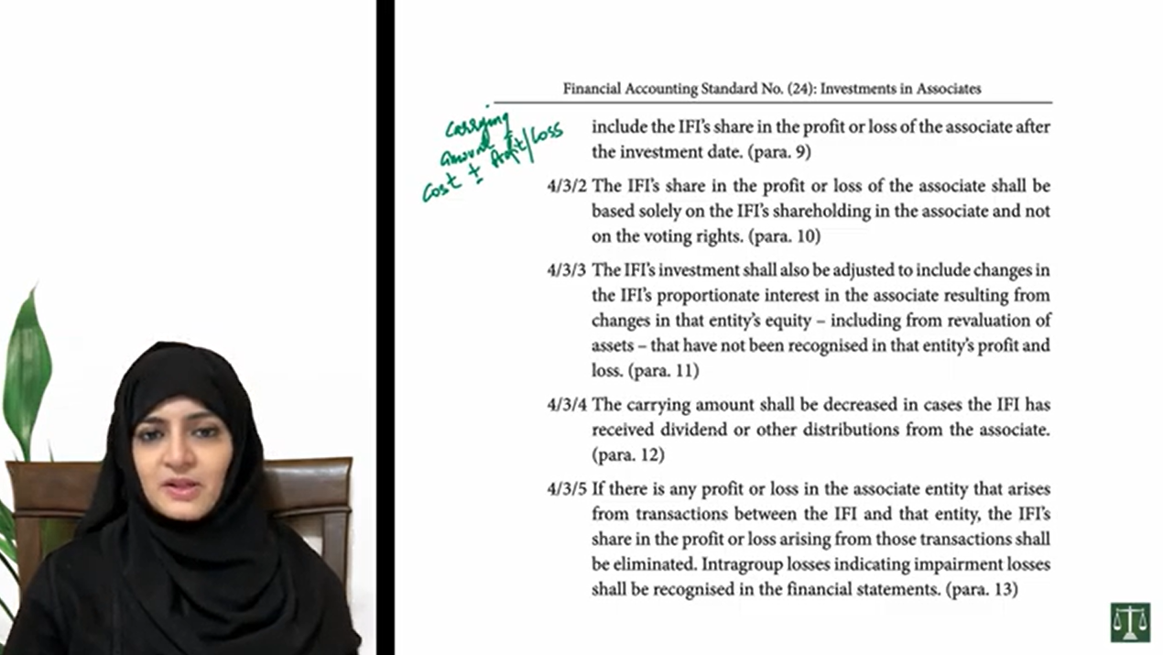
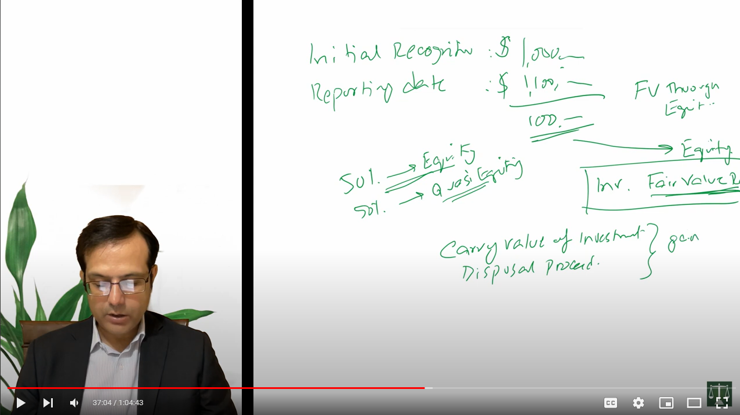
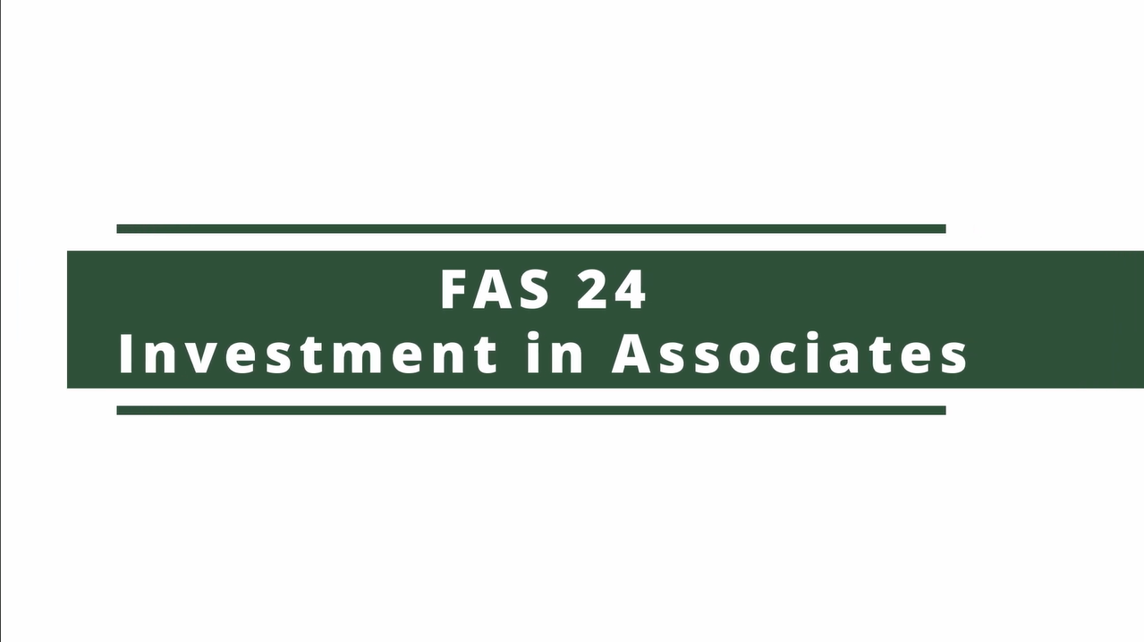
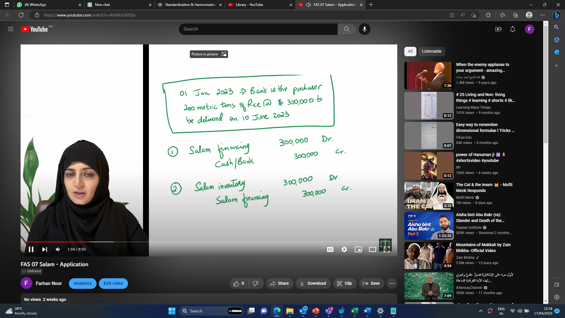
AAOIFI E-learning portal
23

Slide 24
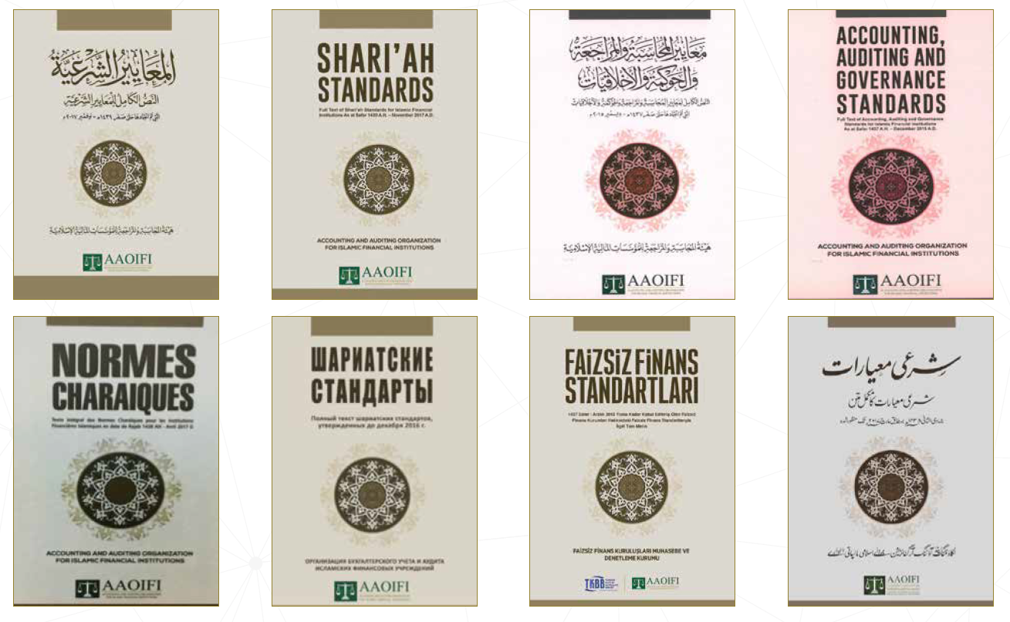
AAOIFI standards – available in various languages
PRINTED
Arabic
English
Russian
French
Turkish
Urdu
Bengali
TRANSLATION IN PROGRESS
Bahasa Indonesia
Mandarin
Source: SECP

Slide 25
+973 1724 4496
+973 35947400
ssiddiq@aaoifi.com

